Slide 1
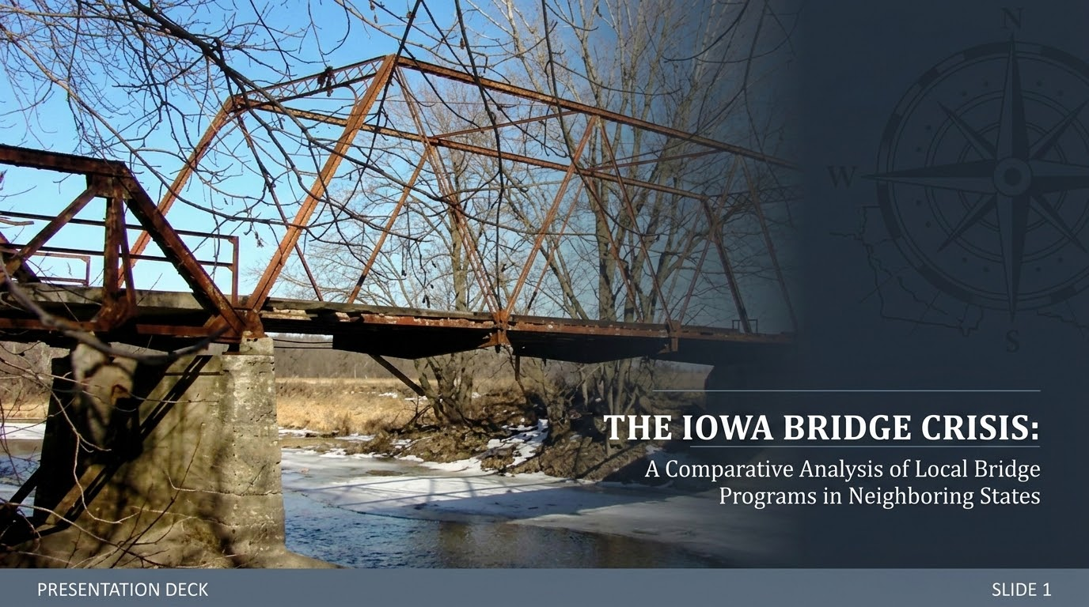

Slide 2
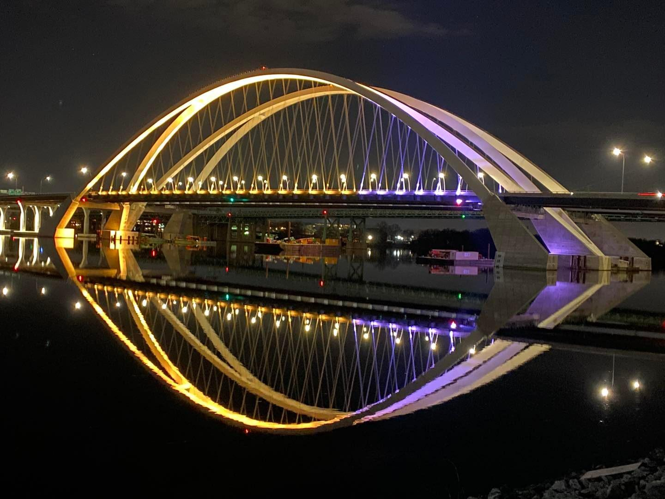
Presenters
Branden Stepanski | Iowa Department of Public Safety
Caleb Jans | City of Perry, Iowa
Jeremy Thayer | Independent
Rhonda Rairden-Nelson | Iowa Department of Health and Human Services
Sammie Nobles | Iowa Public Employees’ Retirement System
Zahrah Alghalibi | Iowa Department of Transportation

Slide 3
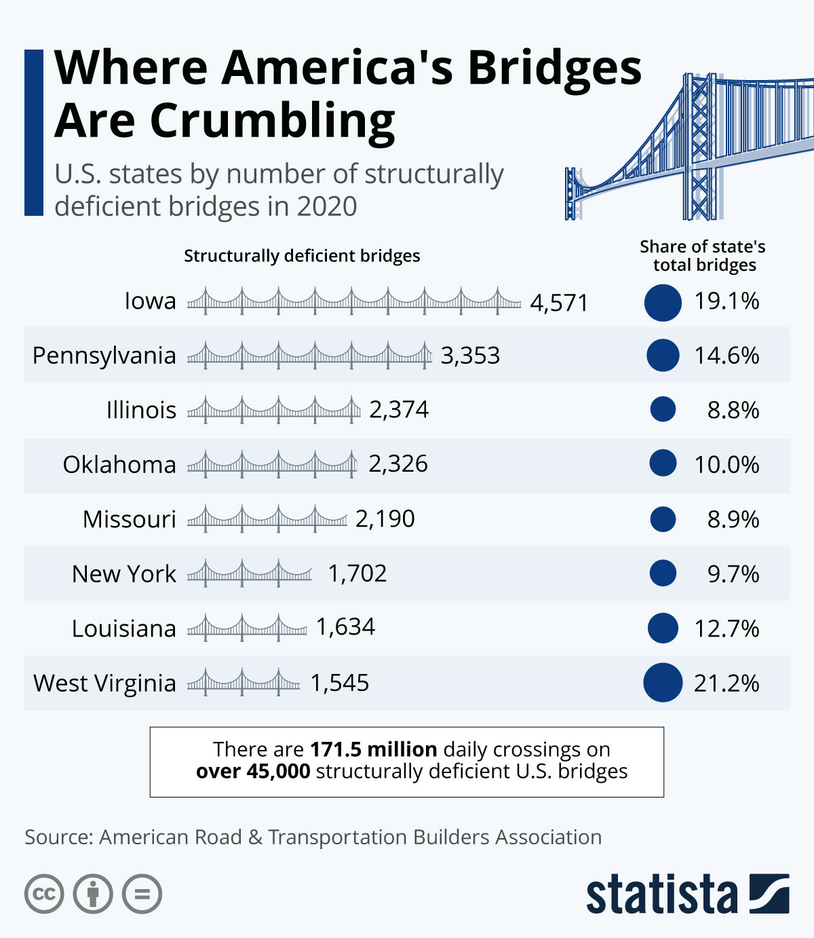
Iowa's Bridge Infrastructure
#1 Deficient Rating: Iowa ranks worst in the nation for structurally deficient bridges.
Massive Asset Volume: Manages 23,685 bridges, representing one of the largest state inventories.
20% Decay Rate: Approximately 1 in 5 structures are currently classified in poor condition.
Depopulation Challenges: Poor bridges sit heavily in rural areas with shrinking property tax bases.

Slide 4
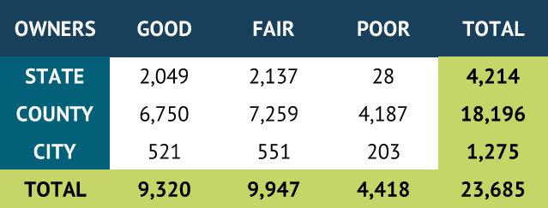
Iowa Bridge Data
Poor category does not indicate there is a safety issue
A bridge will be closed upon finding it is unsafe
Focus is on County bridges
2025 Annual Bridge Report, Iowa Department of Transportation
Notes:
Good: No repairs needed
Fair: Some repairs needed
Poor: Extensive repairs needed

Slide 5
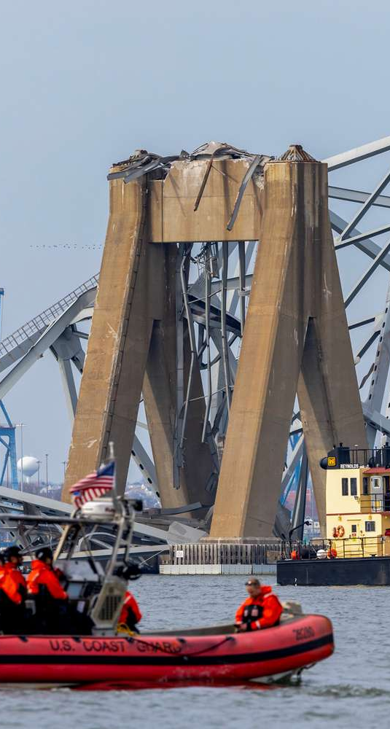
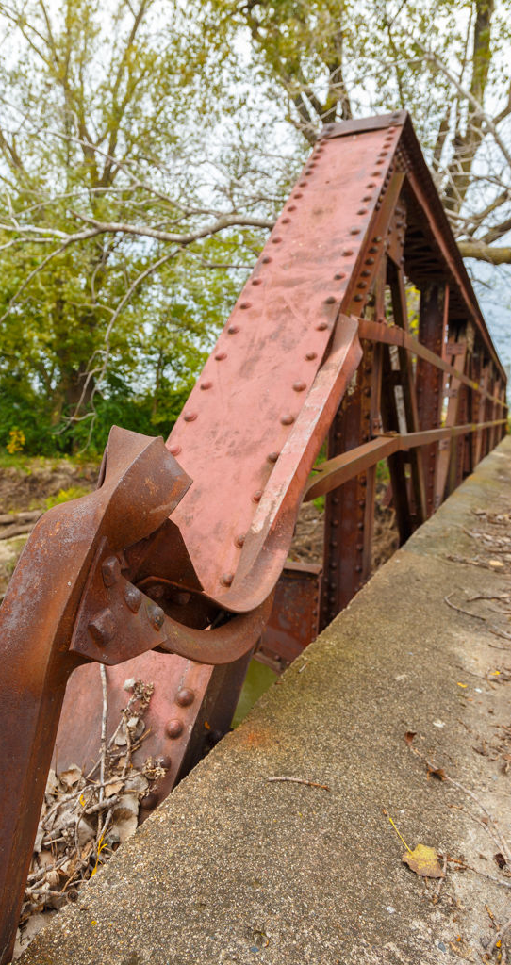
Structural vs Design Issues
Design Deficient Bridge
Structurally Deficient Bridge
Structural Deficiency
  physical deterioration
  damage requiring maintenance.
Functionally(Design) Deficiency:
  obsolete design
  fails to meet current standards.
March 2024: Francis Scott Key Bridge (Baltimore, MD), collapse
Skunk River Bridge (Damage from a tree fall. Credit: Photo taken by Kevin Skow in Sept.2014)
Notes:
March 2024: Francis Scott Key Bridge in Baltimore, MD collapsed after the cargo ship “Dali” lost power and struck a bridge pier- only the pier should had fallen; Skunk River Bridge in Story County, IA just about 4 miles southeast of Ames

Slide 6
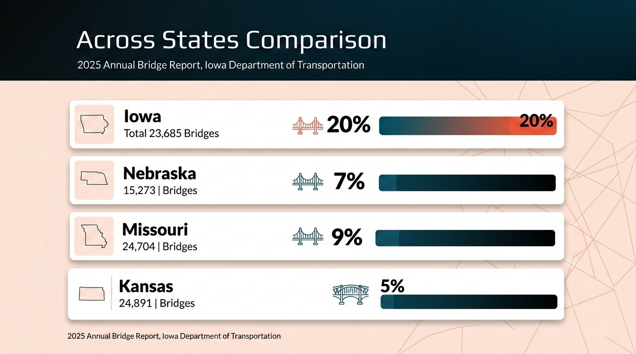
Comparison of Deficient Bridges
State Rankings | ARTBA Bridge Report

Slide 7
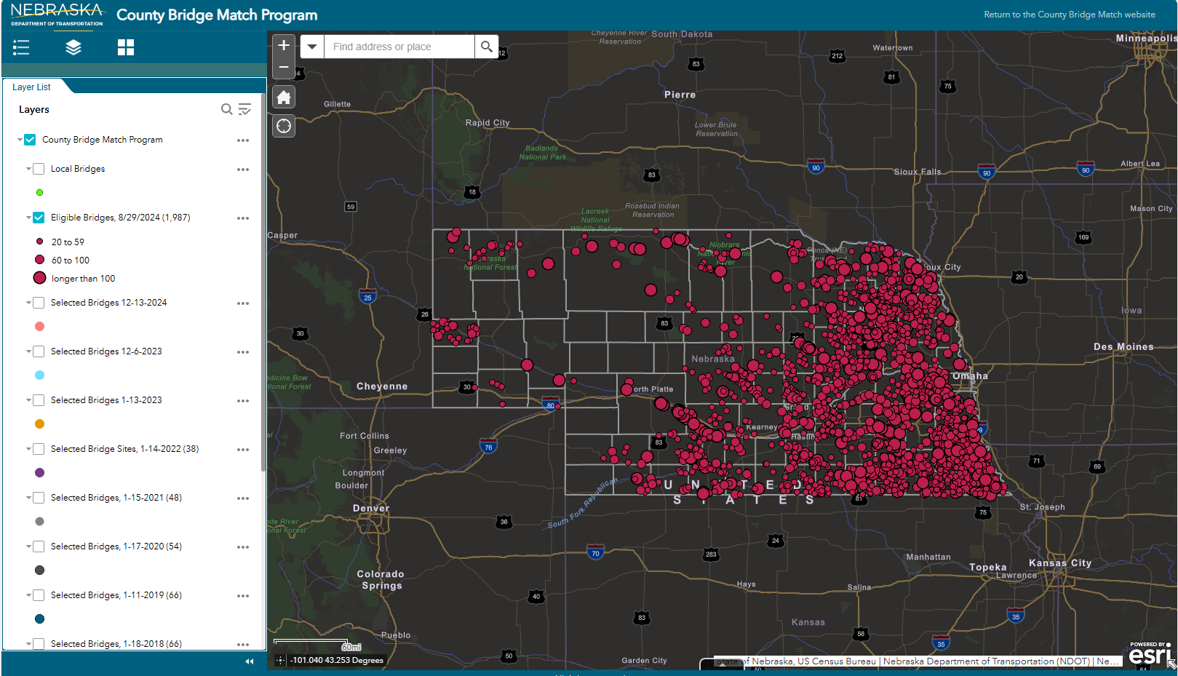
The Nebraska County Bridge Match Program (CBMP)
To improve and innovate local bridge infrastructure
Notes:
Supporting Local infrastructure, Improving rural connectivity

Slide 8
2025 Nebraska Bridge Report
Asset Owner | Good (%) | Fair (%) | Poor (%) | Total Assets
State Maintained | 69.1% | 27.9% | 2.5% | 3,542
County Secondary | 47.4% | 34.9% | 7.9% | 11,218
City Municipal | 53.4% | 41.1% | 4.1% | 513
Weighted Average | 52.6% | 33.5% | 6.5% | 15,273

Slide 9
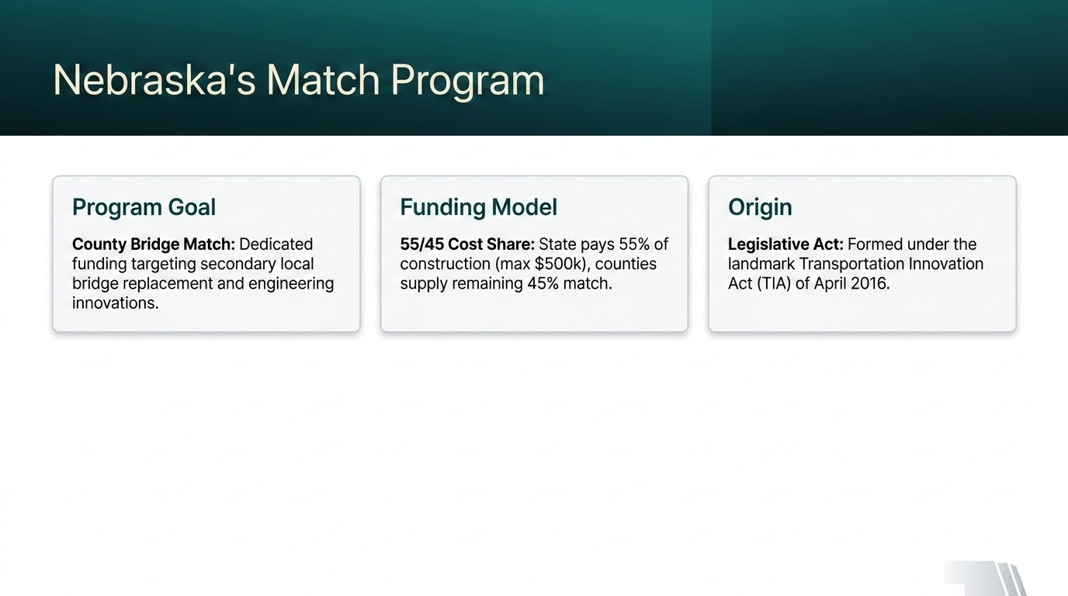

Slide 10

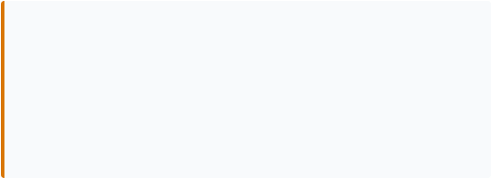
CBMP Eligibility & Process
Eligibility Requirements
Spans must fulfill three core standards:
Asset Condition: Currently rated poor.
Bridge Length: Span must exceed 20 feet.
Roadway Class: Local road or higher.
Application Process
Systematic selection structure:
LPA Proposals: Counties submit annual bids.
NDOT Review: Vetting by bridge committee.
Agreements: Selected counties sign fast-track builds.
Notes:
Selected Bridges: County must submit the following three items for the construction of the new or repaired bridges: material invoices, equipment costs, and labor costs.
Funding: The program funds 55% of eligible bridge construction costs (up to $500,000), with counties providing a 45% match.
County Help: Participation is voluntary, and counties retain local control
The Work: using their own consultants and contractors for the work.

Slide 11
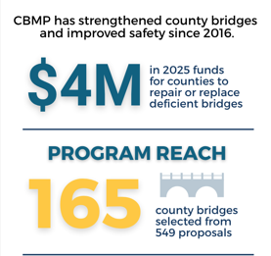
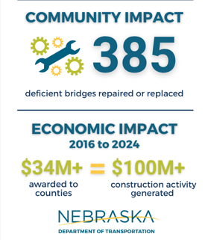
CBMP Takeaways
Notes:
Accelerates Bridge improvements statewide, reduces backlog of deficient bridges, supports local economies and rural communiti, enhances public safety and transportation reliability

Slide 12
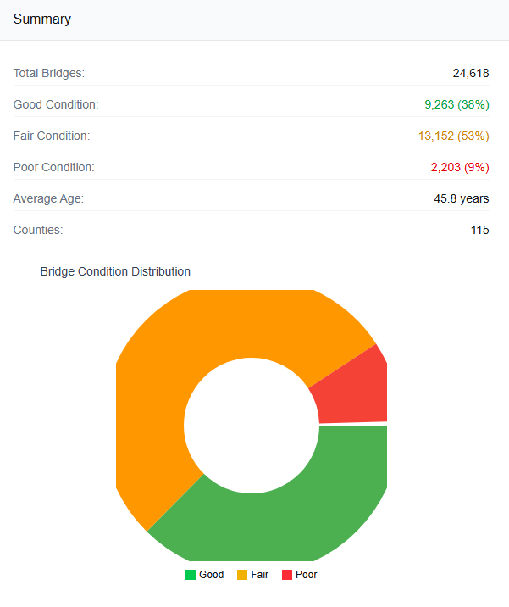
Missouri Regional Highway Bridge Program (HBP)
Missouri ranks 4th in the nation for structurally deficient bridges

Slide 13
2025 Missouri Bridge Report
Asset Owner | Good (%) | Fair (%) | Poor (%) | Total Assets
State Maintained | 29% | 64% | 7% | 10449
Local Public Agency | 43% | 47% | 10% | 14255
Weighted Average | 37% | 54% | 9% | 24704
Source: Missouri Bridge Toolbox (combines county and city data into Local Agency category)

Slide 14

Missouri’s Bridge Program
Funding Base
Federal Core: Regional Highway Bridge Program (HBP) utilizes federal infrastructure funding.
Management
7 MoDOT Districts: Decentralized system manages funds regionally, keeping administration close to projects.
Match Plan
80/20 Division: Federal programs cover 80% of project bills. LPAs provide remaining 20% match.

Slide 15
HBP Selection & Criteria
Application Call
MoDOT runs annual LPA bids evaluated on key local variables:
Physical Ratings: Core structural integrity scores.
Detour Impact: Focuses on school buses and safety routes.
Ag Freight: Local agricultural transport demands.
Regionalized Vetting
Reviews move through defined pipelines:
District Level: Vetted regionally for compliance.
State Review: Final approval and awards.

Slide 16
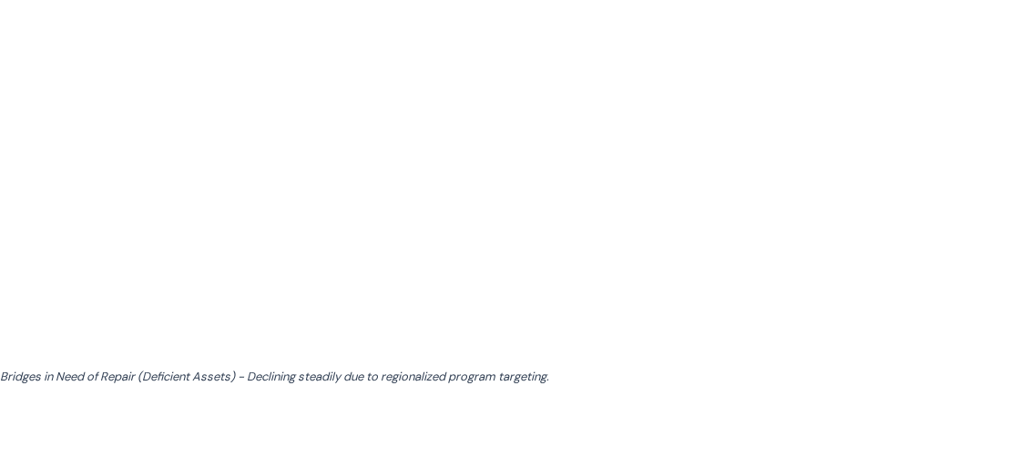
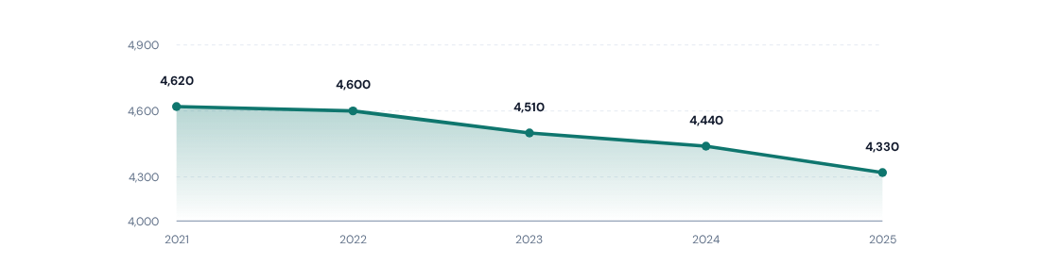
HBP Trends & Success

Slide 17
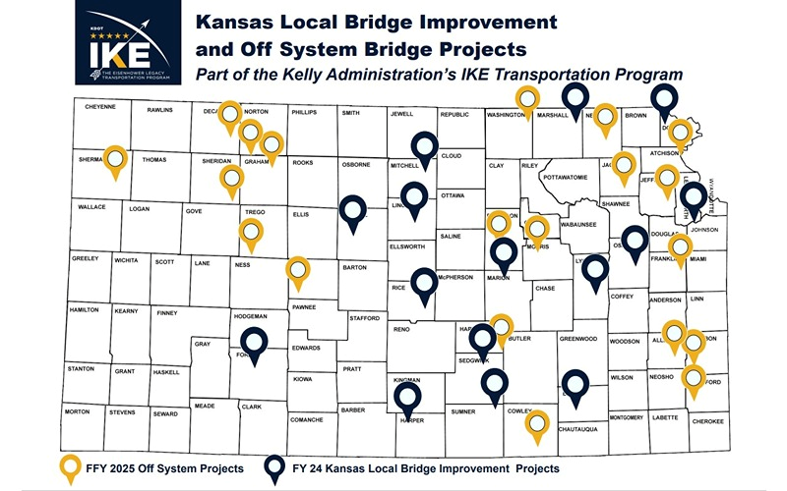
The Kansas Local Bridge Improvement Program (KLBIP)
A Proven Solution for Rural Infrastructure

Slide 18
2025 Kansas Bridge Report
Asset Owner | Good (%) | Fair (%) | Poor (%) | Total Assets
State Maintained | 54.4% | 44.3% | 1.3% | 5,053
County Secondary | 52.2% | 41.5% | 6.3% | 17,216
City Municipal | 46.5% | 47.3% | 6.2% | 2,539
Other Agencies | 62.7% | 25.3% | 12.0% | 83
Weighted Average | 52.1% | 42.7% | 5.2% | 24,891
Source: LTBP InfoBridge
Other Agencies includes State Park, Forest, or Reservation Agency

Slide 19
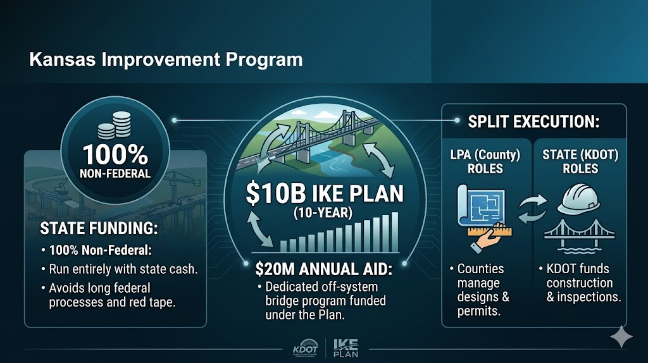

Slide 20
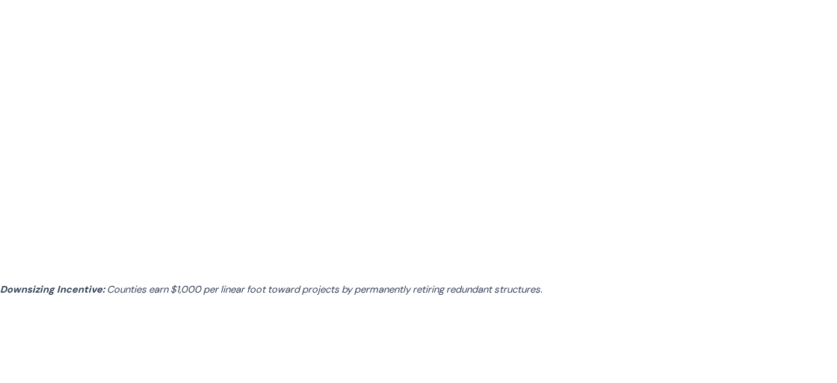
KLBIP Sliding-Scale Match
County Population Density | Local Funding Match
Rural: < 5 People / Sq. Mile | 0% (100% State Funded)
Density: 5 to 10 People / Sq. Mile | 5% local match
Density: >10 to 25 People / Sq. Mile | 10% local match
Density: >25 to 100 People / Sq. Mile | 15% local match
Urban: >500 People / Sq. Mile | 25% local match
0% Match
FOR LOW DENSITY ZONES
Notes:
Fair Funding
Helping Rural Counties
The Removal Incentive

Slide 21
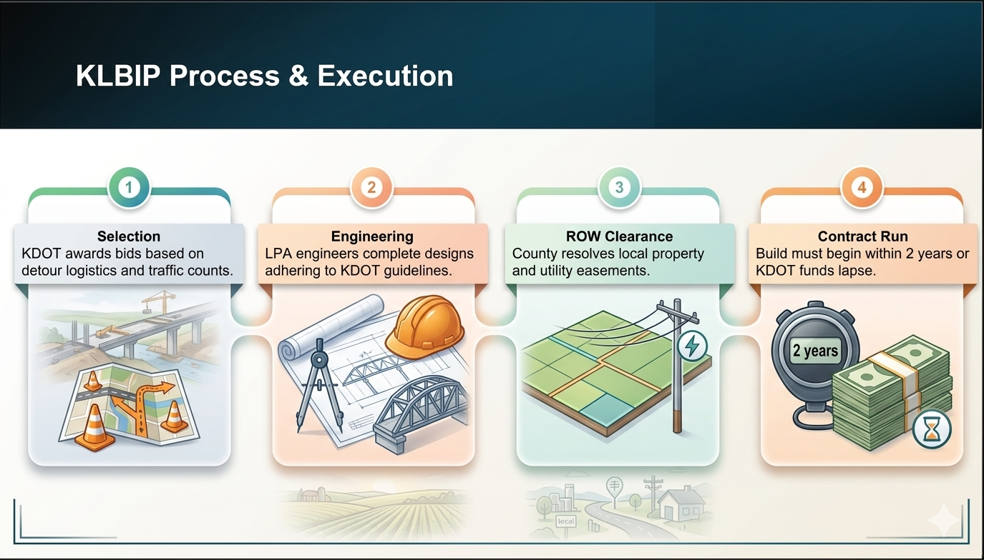

Slide 22
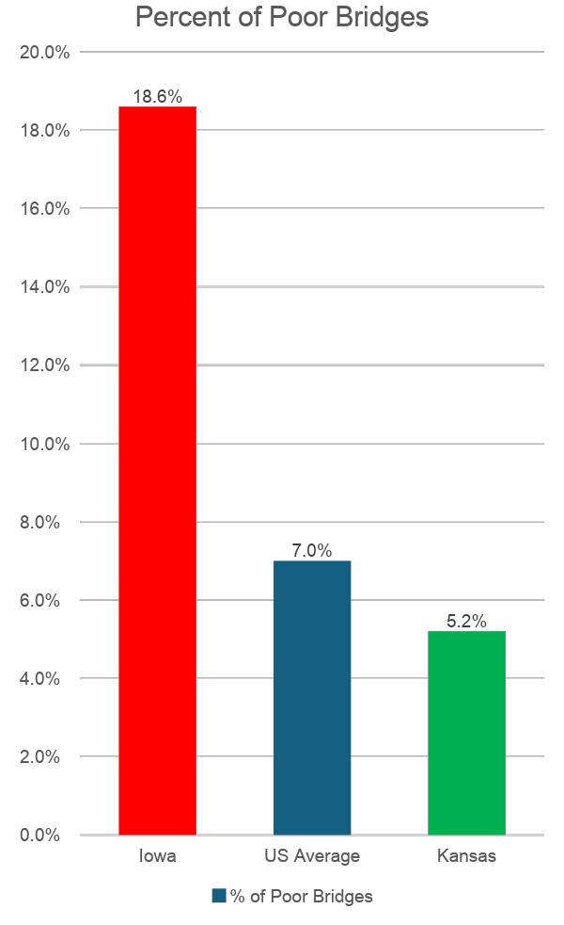
The Big Takeaway: Proof of Success
Proven Performance: Active off-system funding reduced Kansas's decay below national averages.

Slide 23
Iowa Bridge Programs
Federal aid through Highway Bridge Program (HBP)
County Engineer and the County Board of Supervisors
Similar requirements and guidelines as Missouri
4 years of fund accumulation
County Bridge Construction Fund (CBCF)
$2 million annually from Road Use Tax Fund
One candidate per county
up to 80% of eligible costs

Slide 24
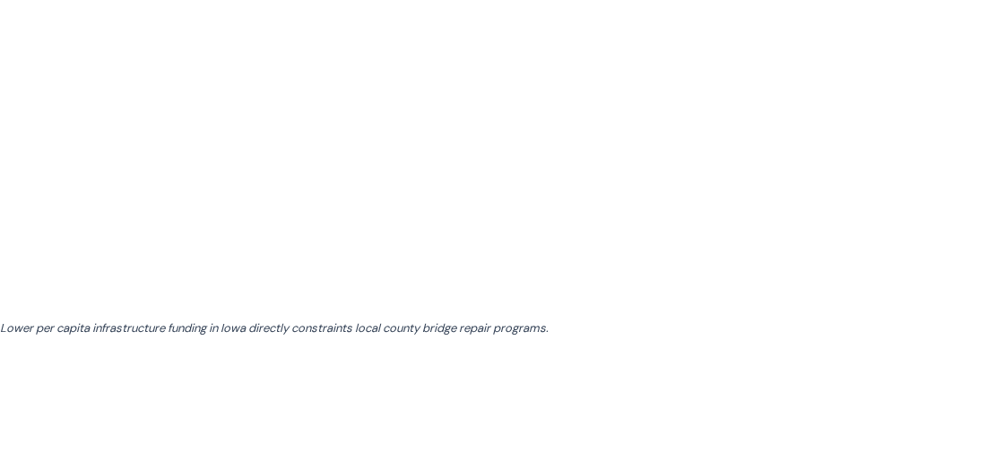
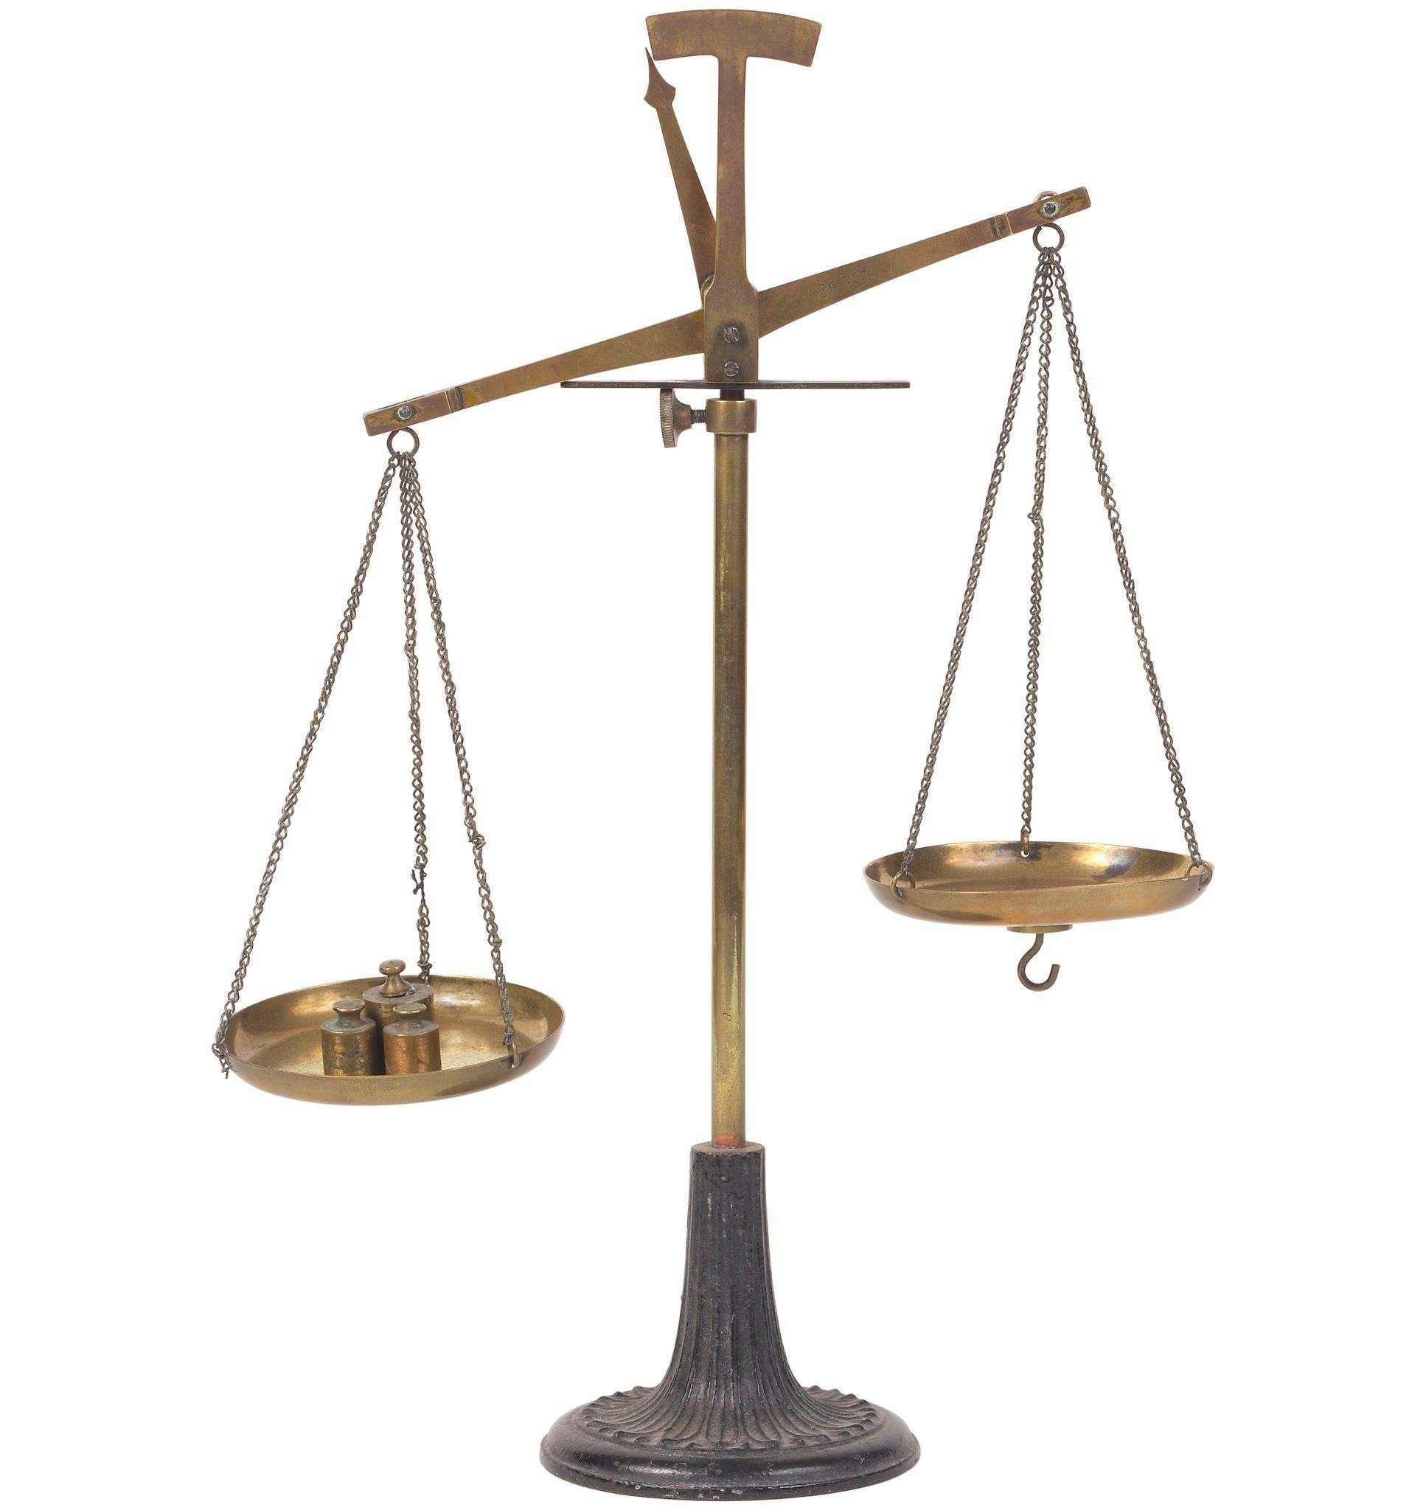
Comparative Funding Analysis
US State | State Budget | State population | Annual Budget Per Capita | Statewide Deficiency Rate
Iowa | $9.74 Billion | 3.2M Residents | $3,043 / Capita | 18.6% Deficient
Missouri | $26.79 Billion | 6.1M Residents | $4,391 / Capita | 9.0% Deficient
Nebraska | $22.46 Billion | 2.0M Residents | $5,700 / Capita | 6.5% Deficient
Kansas | $17.30 Billion | 2.9M Residents | $5,872 / Capita | 5.2% Deficient
2 million
20 million

Slide 25

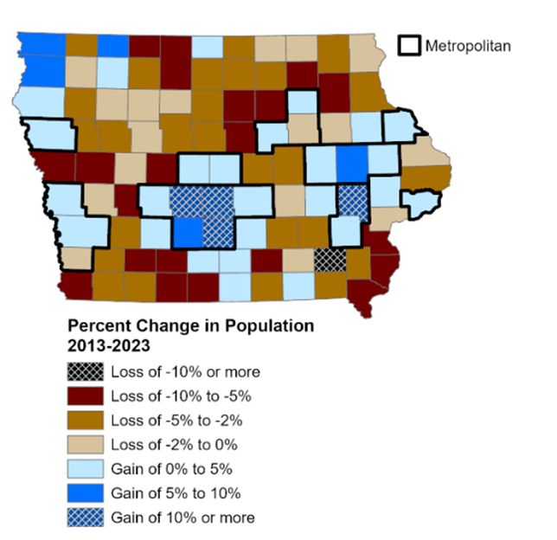
How does Iowa innovate?
Funding
  Creative Solutions
Broader selection criteria
  Community Impact
  Multiple Poor Bridges
Percentage of eligible costs
  20% might not be viable
Incentives
  Smaller communities need less bridges
Iowa at a Glance 2024
Notes:
Funding
-cost in time, gas, manpower vs funding bridge repair

Slide 26
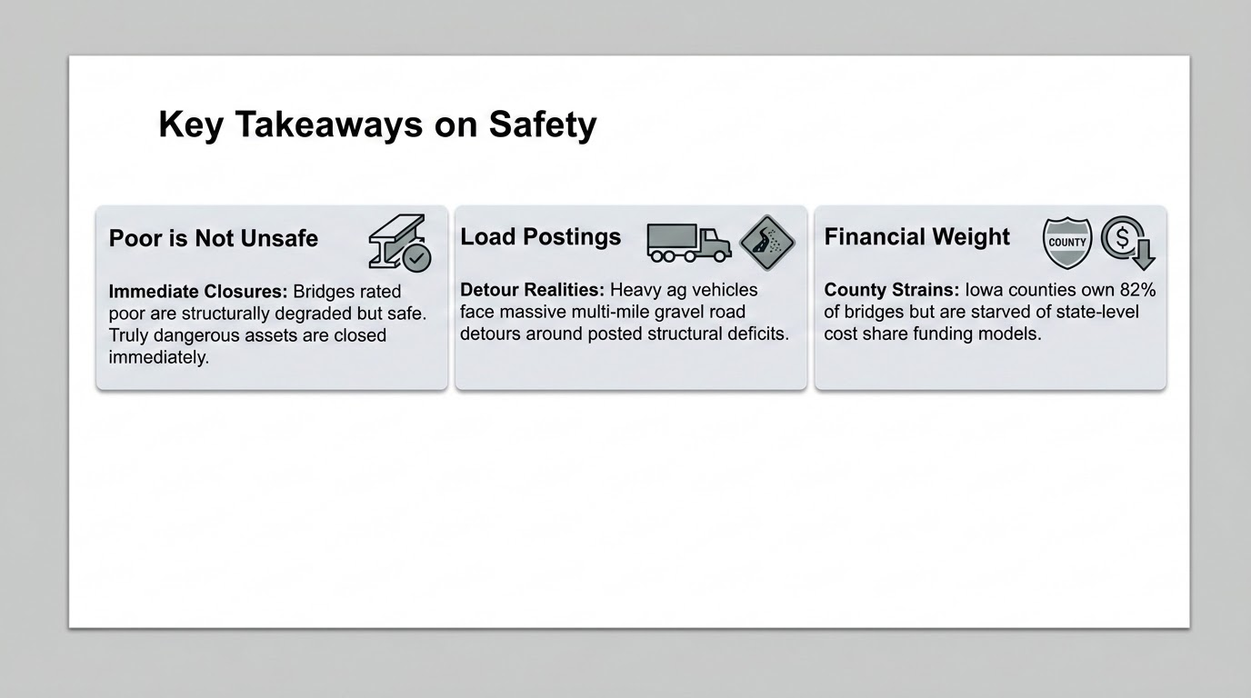

Slide 27
Strategic Recommendations
Cost Sharing
Nebraska Model: Initiate state matching aid to help underfunded rural counties rebuild crucial secondary spans.
Traffic Vetting
Missouri Model: Prioritize allocations based on physical bridge condition and actual detour safety impacts.
Active Retirement
Kansas Model: Waive match rates for low-density areas. Fund ag incentives to retire redundant, low-volume bridges.
Notes:
Funding: The program funds 55% of eligible bridge construction costs (up to $500,000), with counties providing a 45% match.
County Help: Participation is voluntary, and counties retain local control
The Work: using their own consultants and contractors for the work.

Slide 28
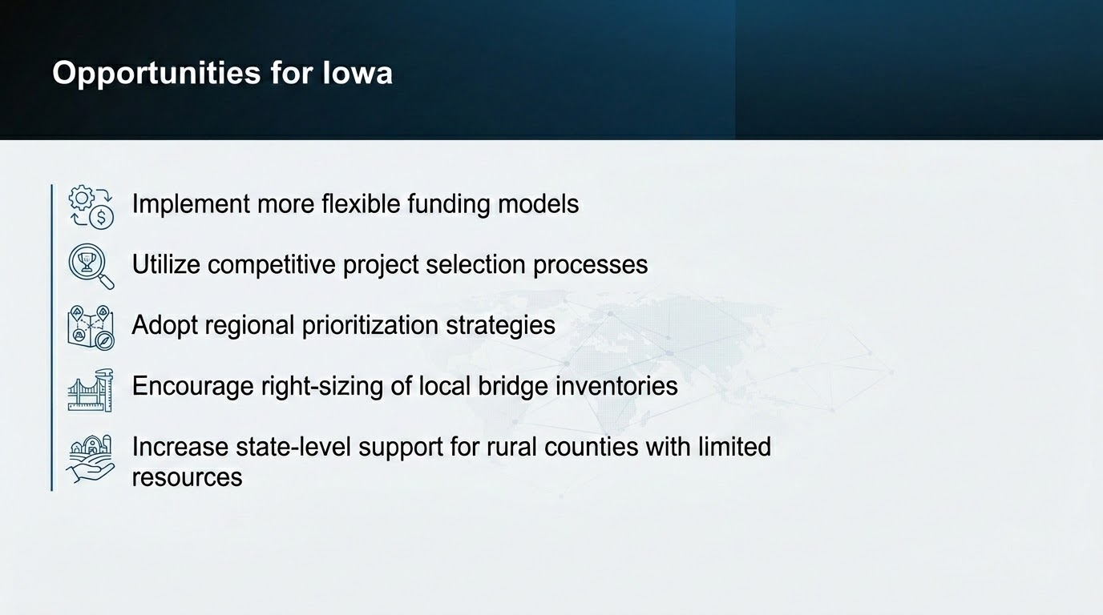

Slide 29
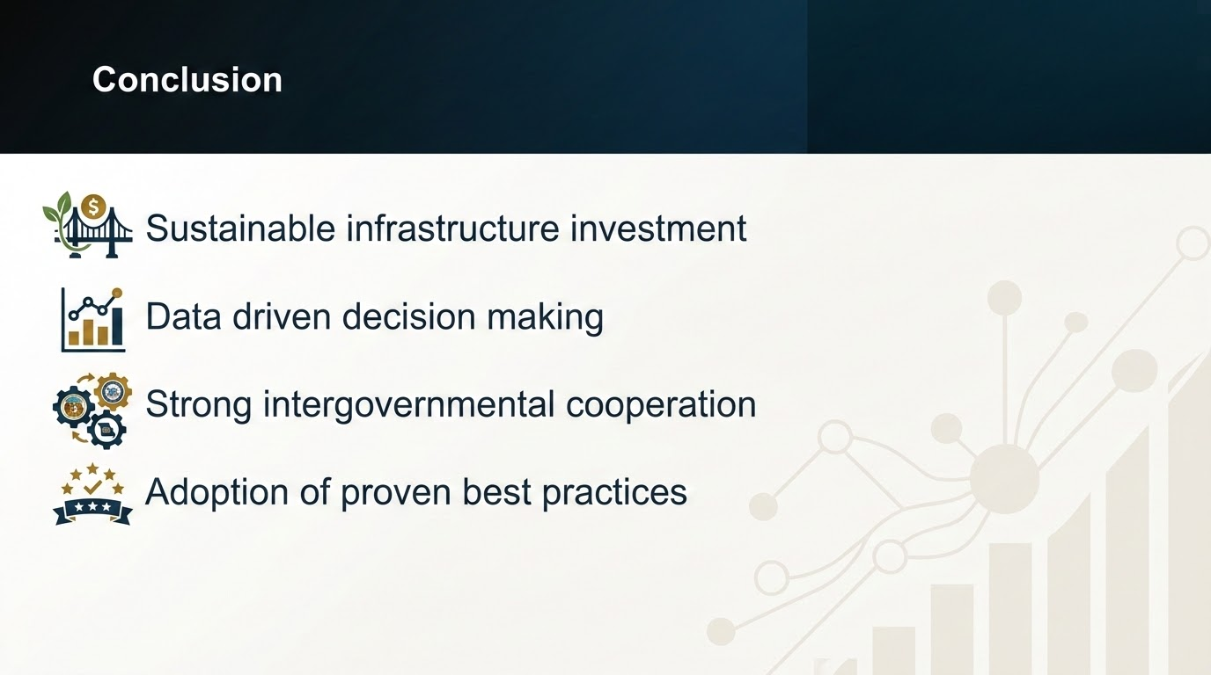

Slide 30

THANK YOU
Q & A

